Slide 1


Prompting-based fake news detection framework for Bengali
Paper ID – 308
Shillpi Mishrra, Arpita Dhar, Somnath Mondal,
Aditi Ghosh, Sauvik Bal
Presented By – Arpita Dhar

Slide 2
Table of Contents
1. Introduction
2. Early Work
3. Problem Description
4. Novelty
5. Methodology
6. Dataset Details.
7. Experimental Result
8. Conclusion
9. Bibliography

Slide 3

Introduction
Rapid growth of digital media has increased the spread of misinformation in Bengali, affecting elections, public safety, and social harmony.
Fake news detection in Bengali is challenging due to limited annotated data, linguistic complexity, and weak generalization of traditional ML/DL models.
Recent advances in LLMs and transformer models enable effective detection through prompt engineering without costly fine-tuning.
Prompt-based methods (zero-shot, few-shot, chain-of-thought) significantly improve performance in low-resource settings.
Experiments on a balanced Bengali dataset show that T5 with chain-of-thought prompting achieves the best results, offering a scalable and data-efficient solution for misinformation detection.

Slide 4
Early Work
Core Idea | Main Findings | Limitations
Prompt-based few-shot paradigm combining Textual prompts with social-graph alignment [18] | Improves few-shot Detection via prompt– graph alignment. | Mostly English; Bengali adaptation Missing requires unavailable social-graph data.
Zero-shot prompt engineering using GPT for cross-domain fake- news detection [19] | Good zero-shot performance with well- designed prompts. | Sensitive to wording; weak in domain- specific tasks; not validated on Bengali.
Task-specific prompt- tuning with contextual augmentation [20] vocabulary remain challenging. | Strong few-shot performance using contextual features. | Trained on high- Resource languages; Bengali tokenization

Slide 5
Core Idea | Main Findings | Limitations
Prompt templates + fine-tuning for Bangla PLMs [21] | Improves Bangla NLP tasks; promising for fake-news classifica- tion. | Not directly tested for fake-news; depends on PLM availability.
BanFakeNews dataset (∼50K Bangla articles) [4] | Provides large Bangla fake-news dataset + baselines. | Dataset imbalance; older methods; no prompt Based approaches.
mBERT with feature augmentation for COVID fake-news detection [22] | Shows multilingual zero-shot potential. | Limited to COVID tweets; not prompt- based.
Deep learning mod- els (BiGRU, LSTM, CNN, BERT) on Bangla fake-news datasets [5] | High accuracy using supervised learning. | Requires full super- vision; not suited for few-shot/prompt- based tasks.

Slide 6

Problem Description
Bengali fake news detection faces challenges due to limited annotated data and weak traditional models. Experiments comparing machine learning and transformer-based methods showed that T5 with chain-of-thought prompting achieved the strongest performance, reaching 92.5% accuracy. This demonstrates that question-prompted LLMs offer an efficient ,low-resource-friendly approach for detecting misinformation in Bengali and other multilingual settings.

Slide 7
Novelty
First application of Chain-of-Thought prompting for Bengali fake news detection.
Low-resource, cost-efficient framework requiring no large datasets or heavy fine-tuning.
Comprehensive evaluation across traditional ML models, transformer models, and multiple prompting techniques.
State-of-the-art performance with 92.5% accuracy using T5 + CoT prompting.
Scalable design suitable for other low-resource Indian languages.

Slide 8
Methodology
The study used a hybrid strategy that integrated state-ofthe-art transformer-based architectures (e.g., T5,BERT) with conventional machine learning classifiers (like SVM, Logistic Regression).

Slide 9
Traditional Machine Learning Models
Logistic Regression: Linear model for binary classification, interpretable and efficient but limited in capturing non-linear patterns.
Decision Tree: Recursively splits features into a tree structure; simple but prone to overfitting.
Random Forest: Ensemble of decision trees that reduces overfitting and improves prediction stability.
Gradient Boosting: Sequentially builds weak trees to correct previous errors, capturing complex patterns effectively.

Slide 10
Transformer-Based Architectures
BERT: Uses masked word prediction to understand context from both sides of a sentence, aiding Bengali fake news detection.
RoBERTa: Enhanced BERT trained on more data with improved tuning, providing stronger text representations and higher accuracy.
T5: Text-to-text transformer that outputs ”real” or ”fake” effective in zero-shot, few-shot, and chain-of-thought prompting.

Slide 11
Prompt Techniques
Zero-shot prompting technique
Few-shot prompting technique
Chain-of-thoughts prompting technique

Slide 12
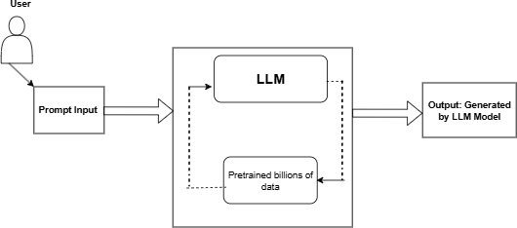
Prompt Engineering
Figure: Schematic diagram of prompt engineering

Slide 13
Experimental Setup
Models trained using PyTorch and Hugging Face Transformers on NVIDIA GPU (12 GB) with 32 GB RAM.
AdamW optimizer with learning rate 2e-5 to 5e-5 and batch size 8–16.
Trained for 3–5 epochs; early stopping applied when validation loss plateaued.
Dataset split: 70% training, 15% validation, 15% testing with 5-fold cross-validation.
Training time: BERT/RoBERTa 20–25 min/epoch; T5 35–40 min on A100 GPU; ML models trained in minutes.

Slide 14
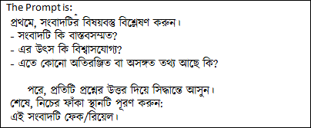
Prompt Example-1
Figure: Chain-of-Thought prompt for Bert Model

Slide 15
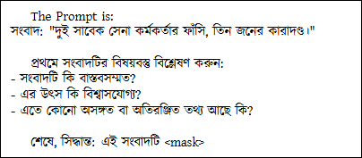
Prompt Example-2
Figure: Chain-of-Thought prompt for RoBerta Model

Slide 16

Dataset Details

Slide 17
Experimental Results
Category | Model | Accuracy | Precision | Recall | F1
Fake News | Logistic Regression | 75 | 69 | 35 | 45
 | Decision Tree | 65 | 43 | 46 | 44
 | Gradient Boosting | 74 | 79 | 18 | 29
 | Random Forest | 73 | 65 | 24 | 35
 | BERT | 59 | 64 | 43 | 53
 | RoBERTa | 51 | 51 | 47 | 49
 | T5 | 64 | 100 | 37 | 54
True News | Logistic Regression | 75 | 76 | 84 | 45
 | Decision Tree | 65 | 75 | 73 | 74
 | Gradient Boosting | 74 | 73 | 98 | 84
 | Random Forest | 73 | 74 | 94 | 83
 | BERT | 59 | 57 | 76 | 65
 | RoBERTa | 51 | 51 | 55 | 53
 | T5 | 64 | 100 | 100 | 100
Figure: Performance Comparison of Traditional Machine Learning Models and
Transformer-Based Models

Slide 18
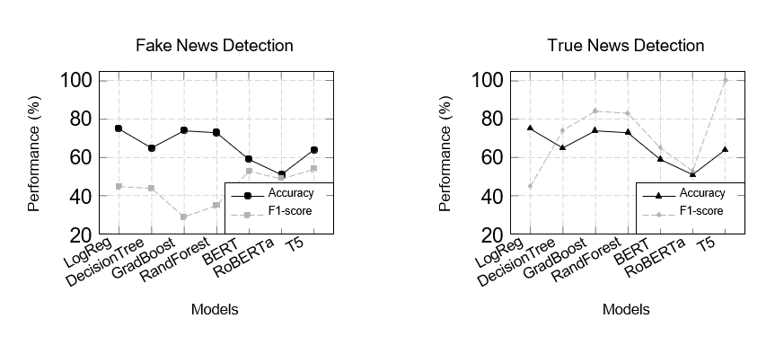
Performance Comparison of Models

Slide 19
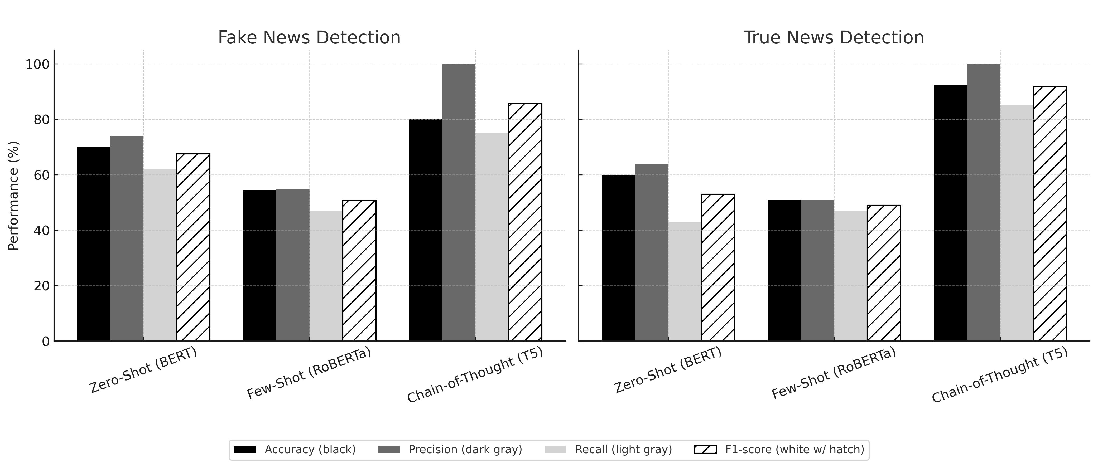
Performance of Prompting Techniques on Bengali Fake News Detection

Slide 20
Conclusion
The study evaluates Bengali fake news detection using rapid design and multiple ML methods, including BERT, RoBERTa, and T5.
Traditional classifiers show moderate accuracy but lack robustness and memory against deceptive content.
Chain-of-thought prompting greatly boosts transformer performance especially T5, even in low-resource settings, emphasizing the need for larger and more diverse datasets.

Slide 21
Bibliography
Rahman, M., Ahmed, F., & Sultana, J., ”Combating misinformation in Bangla: Challenges and resources,” Proceedings of the 2023 Conference on Empirical Methods in Natural Language Processing (EMNLP), pp. 11245–11256, 2023.
Castillo, C., Mendoza, M., & Poblete, B., ”Information credibility on Twitter,” Proceedings of the 20th International Conference on World Wide Web (WWW ’11), pp. 675–684, ACM, 2011.
Wang, W. Y., ”Liar, Liar Pants on Fire: A new benchmark dataset for fake news detection,” Proceedings of ACL 2017, pp. 422–426, 2017.
Hossain, M., Hasan, M., & Murase, H., ”BanFakeNews: A benchmark dataset for fake news detection in Bangla,” Proceedings of LREC’20, pp. 2869–2876, 2020.
Roy, F., Surname, A., et al., ”Enhancing Bangla fake news detection with BI-GRU and deep learning models,” arXiv:2401.12345, 2024.
Brown, T., Mann, B., Ryder, N., Subbiah, M., Kaplan, J. D., Dhariwal, P., et al., ”Language models are few-shot learners,” NeurIPS, vol. 33, pp. 1877–1901, 2020.

Slide 22
Bibliography
Devlin, J., Chang, M.-W., Lee, K., & Toutanova, K., ”BERT: Pre-training of deep bidirectional transformers for language understanding,” Proceedings of
NAACL-HLT, 2019.
Radford, A., Narasimhan, K., Salimans, T., & Sutskever, I., ”Improving language understanding by generative pre-training,” OpenAI Technical Report, 2018.
Liu, P., Yuan, W., Fu, J., Jiang, Z., Hayashi, H., & Neubig, G., ”Pre-train, prompt, and predict: A systematic survey of prompting methods,” Proceedings of
NAACL-HLT, pp. 4093–4114, 2021.
Schick, T., & Schu¨tze, H., ”Exploiting cloze questions for few-shot text classification and natural language inference,” Proceedings of EACL 2021, pp. 255–269, 2021.
Chowdhury, T., Ghosh, D., & Bhattacharya, P., ”Zero-shot learning for
low-resource Indian languages using multilingual transformers,” In FIRE, 2023.
Rahman, S., Mondal, T., & Barman, A., ”Few-shot prompting for hate speech detection in Bengali using language models,” arXiv:2401.XXXX, Under Review, 2024.

Slide 23
Bibliography
Banerjee, S., Ghosh, P., & Das, A., ”Chain-of-thought prompting for low-resource languages: Experiments with Bengali,” Findings of ACL, pp. 845–857, 2024.
Tacchini, E., Ballarin, G., Della Vedova, M. L., Moret, S., & Alfaro, L., ”Some like it hoax: Automated fake news detection in social networks,” arXiv:1704.07506, 2017.
Ruchansky, N., Seo, S., & Liu, Y., ”CSI: A hybrid deep model for fake news detection,” Proceedings of CIKM ’17, pp. 797–806, 2017.
Zhou, X., & Zafarani, R., ”A survey of fake news: Fundamental theories, detection methods, and opportunities,” ACM Computing Surveys, 53(5), pp. 109–110940, 2020.
D’Ulizia, A., Ferrara, F., & Grifoni, P., ”Fake news detection: A survey of evaluation datasets and techniques,” Information, 12(3), 109, 2021.
Wu, X., Zhang, X., & Li, J., ”Prompt-and-align: Prompt-based few-shot fake news detection with social graph alignment,” SIGIR 2023, pp. 1234–1243, 2023.

Slide 24
Bibliography
Alghamdi, M., ”Cross-domain fake news detection using prompt-based zero-shot learning,” Applied Sciences, 14(4), 1234, 2024.
F., & S., ”Few-shot fake news detection via prompt-based tuning and contextual augmentation,” Journal of Intelligent & Fuzzy Systems, 45(6), pp. 789–802, 2023.
F., & S., ”Prompt-based fine-tuning of Bangla language models for sequence classification,” Proceedings of the International Conference on Computational Linguistics, pp. 456–465, 2023.
Kar, S., Thapa, S., & Chakraborty, T., ”No rumours please! A multilingual approach for COVID fake-tweet detection,” CONSTRAINT Workshop, pp. 61–70, 2020.
Wei, J., Wang, X., Schuurmans, D., Bosma, M., Ichter, B., Xia, F., Chi, E. H., Le,
Q. V., & Zhou, D., ”Chain-of-thought prompting elicits reasoning in large language models,” arXiv:2201.11903, 2022.
Hosmer, D. W., Lemeshow, S., & Sturdivant, R. X., Applied Logistic Regression (3rd ed.), Wiley, 2013.

Slide 25
Bibliography
Breiman, L., Friedman, J. H., Olshen, R. A., & Stone, C. J., Classification and Regression Trees, Chapman and Hall/CRC, 1984.
Breiman, L., ”Random forests,” Machine Learning, 45, pp. 5–32, 2001.
Friedman, J. H., ”Greedy function approximation: A gradient boosting machine,” Annals of Statistics, 29(5), pp. 1189–1232, 2001.
Liu, Y., Ott, M., Goyal, N., Du, J., Joshi, M., Chen, D., Levy, O., Lewis, M., Zettlemoyer, L., & Stoyanov, V., ”RoBERTa: A robustly optimized BERT pretraining approach,” arXiv:1907.11692, 2019.
Raffel, C., Shazeer, N., Roberts, A., Lee, K., Narang, S., Matena, M., et al., ”Exploring the limits of transfer learning with a unified text-to-text transformer,” JMLR, 21(140), pp. 1–67, 2020.

Slide 26
Thank You

